Slide 1

Student Flow

Slide 2
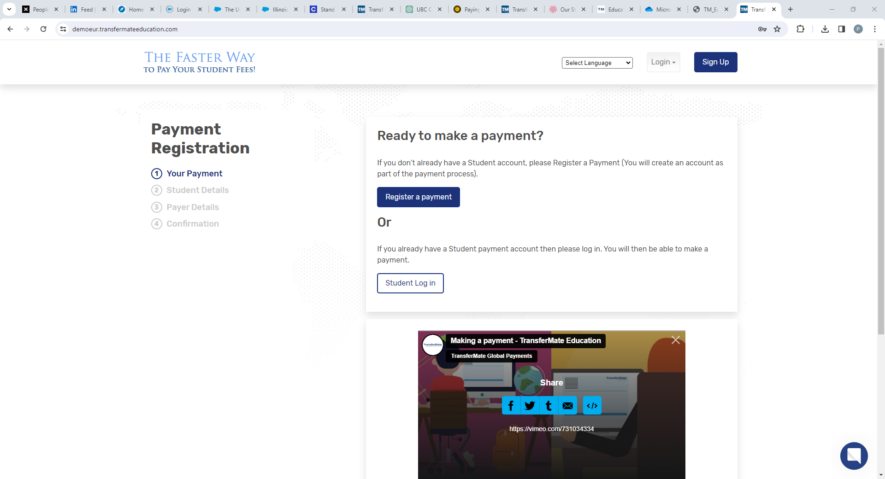

Slide 3
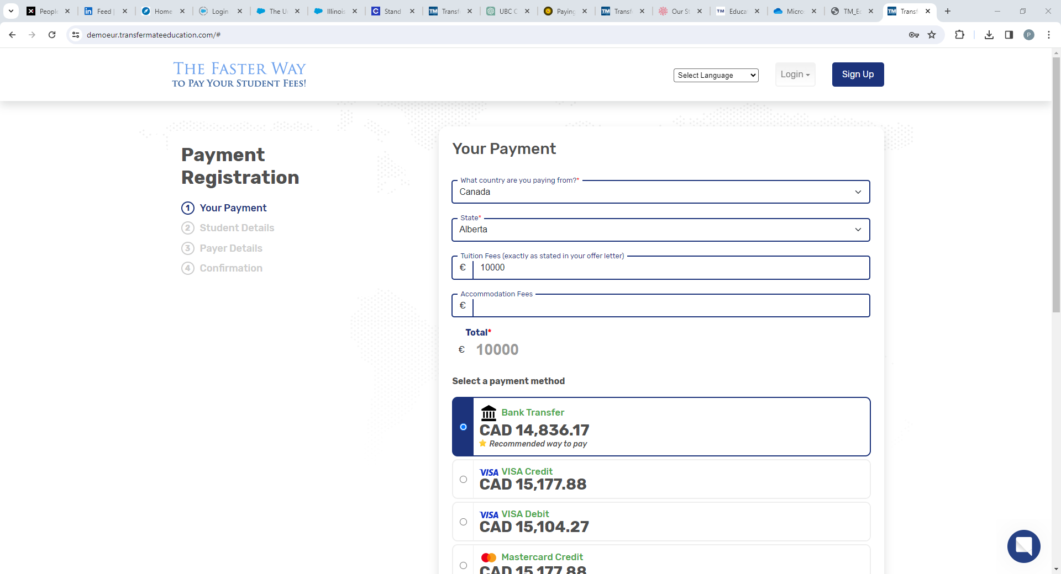

Slide 4
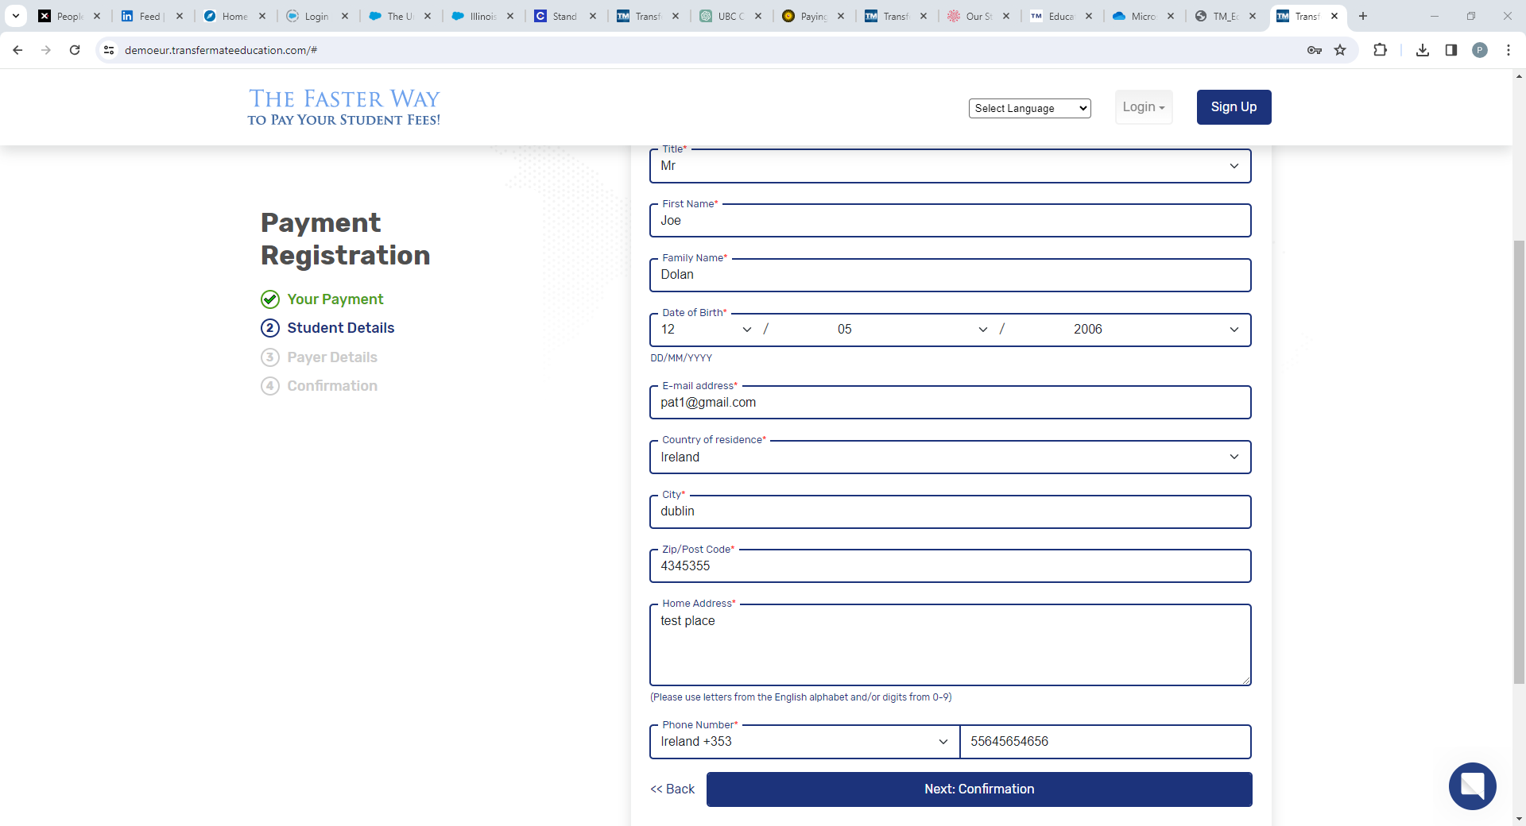

Slide 5
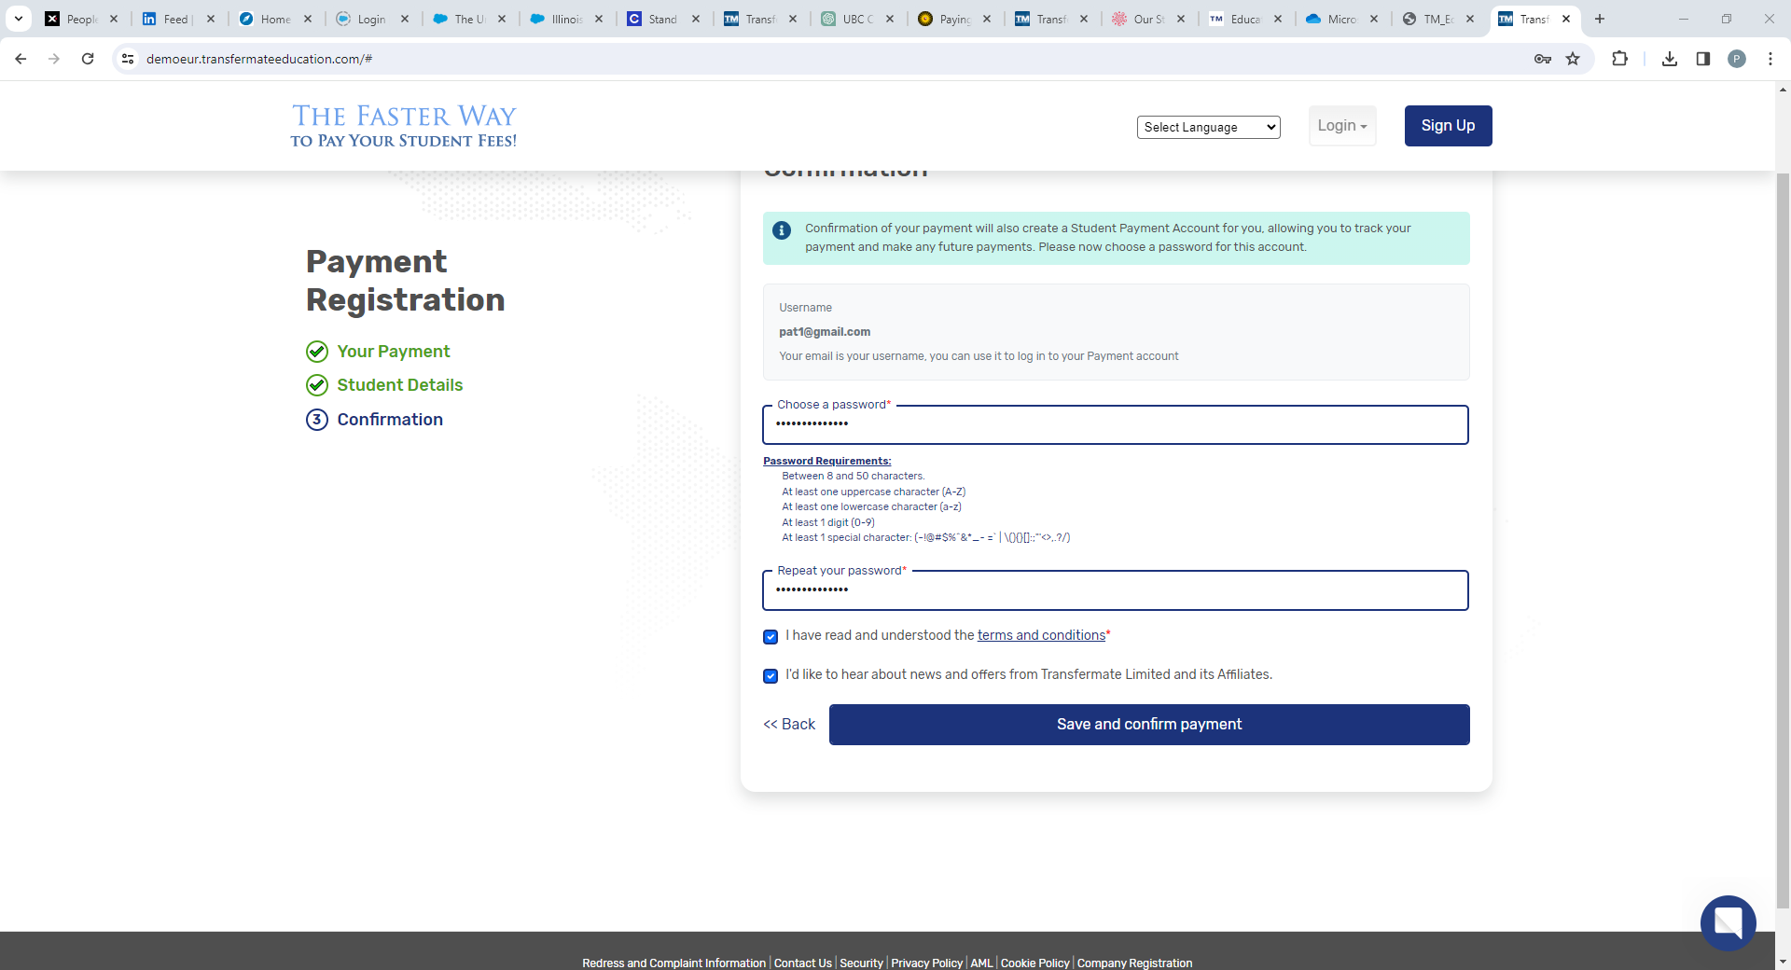

Slide 6
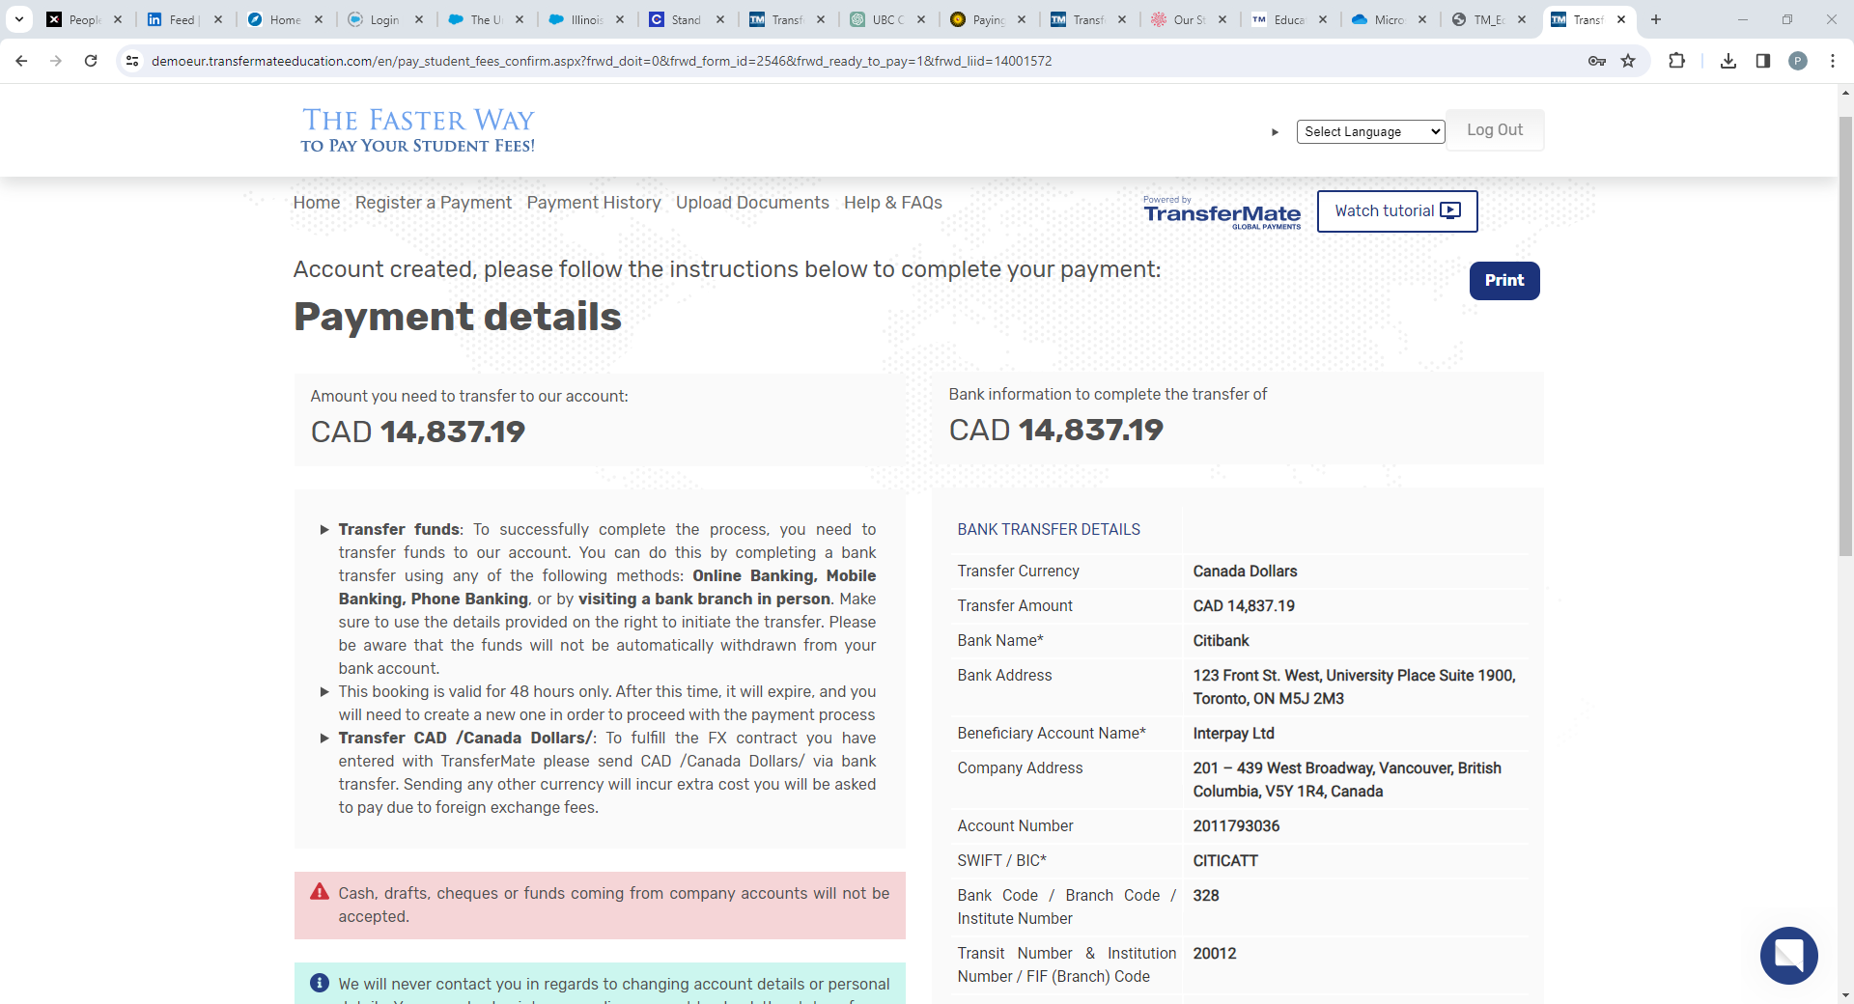

Slide 7


Transfermate How to Pay Links
How to Make a Payment with TransferMate Education 2mins 16 secs
https://transfermate.wistia.com/medias/ac1t7yi048
Short - 37 seconds

