Slide 1



How to Develop a Growth Mindset

Slide 2
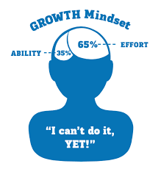
Growth Mindset
https://youtu.be/wh0OS4MrN3E

Slide 3

Finish the sentence…
I was never good at…

Slide 4
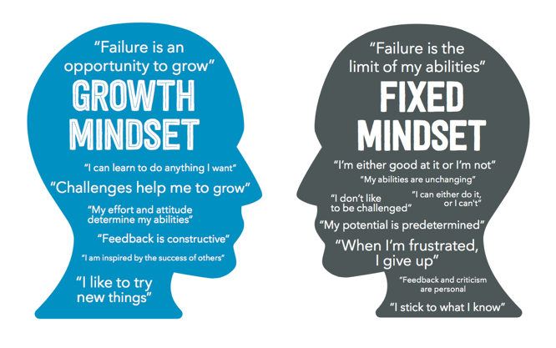
Learning Mindsets
Mindsets are our beliefs and perceptions about learning. They shape how we interpret difficulty, and research shows they are critical predictors of academic performance, persistence, and motivation.

Slide 5
“Your grades are not based on how smart you are. They reflect your behavior and the actions you take.”
Do you agree with this statement? Yes or no and why???

Slide 6
Fixed Mindset: Intelligence is static (lacking in movement, action, or change)
Fixed mindset is like kryptonite to your academic super-hero-ism
Believe that your peers are intelligent or simpleminded
Programmed to have fixed mindset

Slide 7
Use your Failure to Learn
https://youtu.be/LUtcigWSBsw

Slide 8
Growth Mindset: Intelligence can be developed
Hard work and effort will develop your intelligence
Believe you have the power to change your behavior and actions
Takes practice
Self-talk: someone’s thoughts directed toward him or herself
If majority of those thoughts are negative & self-destructive, they negatively impact student’s learning efforts
If self-talk is compassionate & encouraging , learning is easier
Must intentionally evaluate your thoughts/feelings to correct fixed mindset
Must happen gently and gradually to maintain new behavior
Attribute success and failures
Accountable for behavior, which you can control, allows you to know what to do to increase successes and reverse failures
You hold the power to change your results

Slide 9
Recall a time when…
Share an example when you learned something you did not already know…what was that process like?
  Examples:
    Driving a car
    Riding a bike
    Learning to swim
    Learning to play an instrument
    Learning a new language

Slide 10
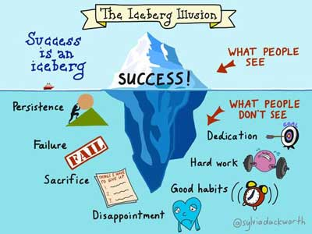
Students need to have a growth mindset and pair it with behaviors to lead to academic success.

Slide 11
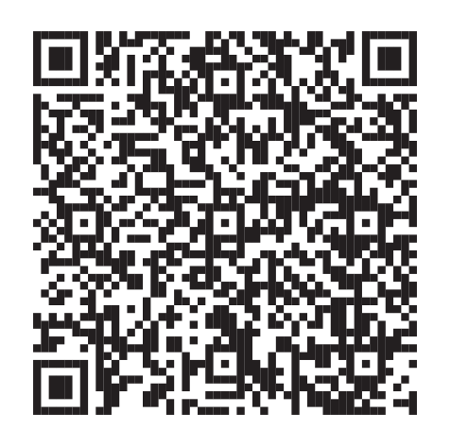
Thank you for your time and attention.
Please complete the survey by taking out your phone and using the QR Code or visiting the link below it.
https://direc.to/hdAi

